Slide 1
Co-production in northern Ireland – challenges and opportunities
Professor john Barry
Queens university Belfast
j.barry@qub.ac.uk

Slide 2
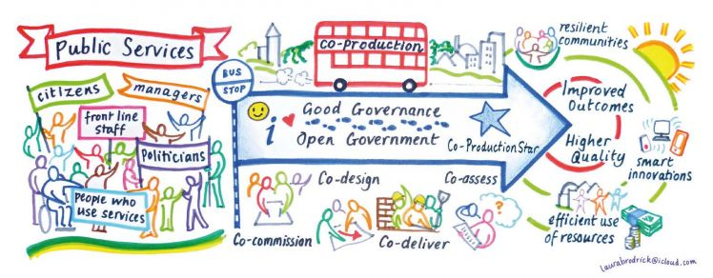
Starting out…some guiding principles
a) everyone has something to contribute;
b) reciprocity is important i.e. giving as well as receiving, not charity;
c) relationships matter, hierarchy (often!) does not;
d) social contributions and outcomes can be as important as financial ones or targets;
e) adopt a positive/asset approach rather than a problem/deficit one;
f) autonomy and support as ‘recognition’, as important as finance for identifying and meeting needs (especially where relationships, imagination and innovation called for).
g) food important…as is sometimes letting go – responsible risk taking !
And to mean and practice all that not simply say it…

Slide 3
Co-­production in public services: a new partnership with citizens, Matthew Horne and Tom Shirley, 2009
“i. Co­production often improves outcomes – evidence shows that interventions that adopt this approach have a big impact on outcomes.
ii. The public frequently want to be more active partners – the public want to be more involved when public services relate directly to them and their family – we usually underestimate people’s willingness to help others.
iii. The value citizens can contribute is significant – the scale and value of the resources that the public contribute is enormous families and communities generate a huge amount of economic value that is unmeasured and unrecognised by public services.
iv. Co­production often improves value for money – evidence also shows that the economic benefits of co­production approaches outweigh the costs.” (p.5)

Slide 4
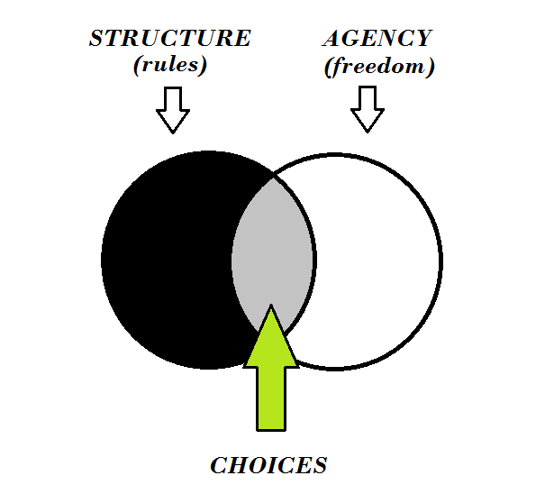
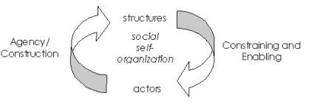
Basic model of social action and social change – structures and agency

Slide 5
SWOT analysis of Co-Production in Northern Ireland
Strengths – relatively strong social economy and community sector
Weakness – novel idea, ignorance and resistance, lack of capacity and shared vision
Opportunities – Community Planning, greater powers to local government, outcome based accountability, ‘progressive austerity’?
Threats – central government instability, ‘consultationitis’, risk averse decision-making culture, unrealistic expectations

Slide 6
Harnessing the power of community
Community development not coextensive with ensuring either 1) good governance within community groups or 2) ensuring better grant application skills and success.
Community as active, source of solutions not simply passive recipients of services
Especially in relation to complex social issues – problems or untapped potential

Slide 7
Community planning – statutory agencies ‘on tap…not on top’
Democratic identification of community needs and priorities
The person who wears the shoes knows where they pinch
Knowledge is power…what gets measured gets done – are we measuring the right things?
Citizen based process – within which service user/rate payer identities and roles are located
Overall direction of travel - Getting public sector out into the community and vice versa – bringing the community into the public sector

Slide 8
Local government reform in northern Ireland
Local government being more innovative in using their
general powers of competence and duty to promote
well-being
Potential of Community Planning
Outcomes/results based accountability
Outcome based decision making, accountability and
performance management

Slide 9

Nihil de nobis, sine nobis or

Slide 10
Social return on investment and social change
“A type of economic analysis that provides a framework for measuring social value. The SROI ratio represents the social value created for each £1 invested. Integral to this is the process of listening to stakeholders, understanding and valuing outcomes”, New Philanthropy Capital
Based not on maintaining the status quo but on social change…therefore based on a theory of social change (so what for example is local government’s ‘theory of social change?’)

Slide 11
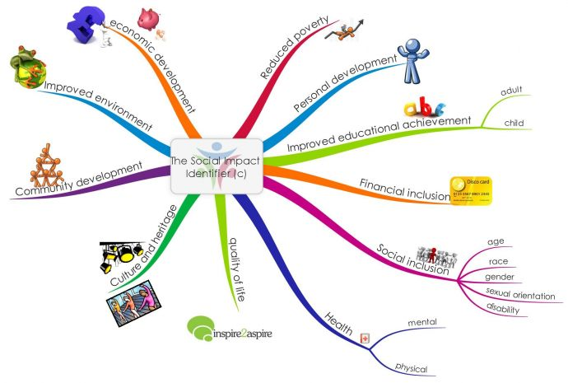
principles of Social Return On Investment
Involve stakeholders
Understand what changes
Value the things that matter
Include only what is material
Do not over-claim
Be transparent
Verify the result

Slide 12
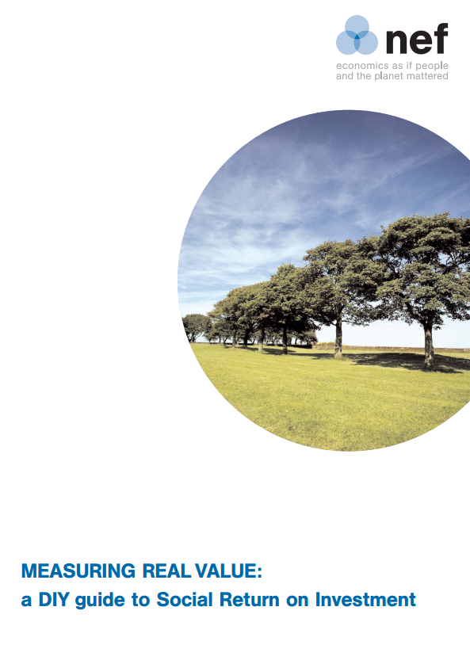


Social return on investment
It attempts to represent in proxy monetary terms the value of changes to stakeholders - values not usually captured in a market economy – social, community and environmental benefits
It gives a voice to stakeholders that have been excluded in the past, e.g. disabled workers and their families
It is based on standard accounting and commercial investment principles
It represents the value created by an activity and helps communicate of the value of the work to ‘the people that matter’
It involves measuring change –what statutory and community groups and citizens and ultimately the state is or should be aiming for

Slide 13
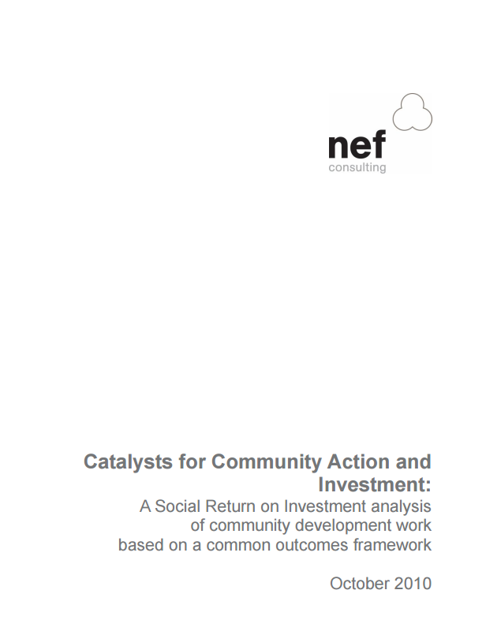
“What is striking in this report is the evidence of what we have always intuitively known – the value of investing in community development work.
The report shows that for an investment of £233,655 in community development activity across four authorities the social return was approximately £3.5 million.
This is an incredible return for statutory investment.” (nef, 2010, p. I; emphasis added)

Slide 14
Culture shift
Genuine listening and relationship building – takes time
Leadership
How to creatively and positively deal with ‘mess’ – from inappropriate expectations, to conflict and misunderstandings, ‘community’ does not speak with one voice…
To open up public sector to not just scrutiny but citizen/user involvement
Greater levels of managed risk-taking – ‘bounded risk taking’ - innovation carries risk of failure

Slide 15
Doing business differently within the public sector
More community engagement
Less focus on bureaucracy and official ‘state-speak’ – target, KPIs, etc.
A new shared language based around a co-created and shared vision (maybe even a shared brand)
Harnessing enthusiasm not dampening it – ‘Yes/maybe …but…’ rather than ‘No…and’
In starting new initiatives personalities as or sometimes more important than processes and structures …

Slide 16

Radical change…getting to the root, the cause not just the effects
Way to mainstream co­production is not through
more and more programmes but to change how
the following are done:
Budgeting;
Strategy setting;
Relationships with civil society;
Performance management;
Professional cultures, including training and CPD

Slide 17
Co-production and performance management
“Performance management systems, which incentivise a focus on short term improvements against narrow ‘top down’ indicators, divert professional attention and commitments away from building relationships” (Horne and Shirley, 2009, p.66)
Indeed developing relationships which take time and which may be unfocused initially, could be viewed as a ‘waste of time’ for busy professionals.
And a ‘compliance culture’ can quickly result in meaningless and socially useless (even if bureaucratically helpful and/or unavoidable) ‘tick boxing’
Frontline service delivery workers are well placed to set up ’peer support networks’ for service users but they are not empowered or incentivised to do so

Slide 18
Only connect….e.m. forster
“What is clear from both research and experience is that there can be no exact guidance, toolkits or how to manuals for co-production. It requires a shift in mind-set about current ways of working from both statutory bodies and communities. Statutory staff often need to use a greater range of interpersonal, relational, facilitative skills rather than a delivery focus being predominant (Nesta 2012)”.
Duneane Community Collective: A co-production pilot, (2017), p. 6

Slide 19
Thank you for listening
Any questions or
comments?

