Slide 1
Food – The Game Changer Incredible things do happen!
Declan Donnelly
Causeway Coast and Glens Borough Council

Slide 2
Food is the solution, not the problem

Slide 3
Better food for all? We live in a world stretched beyond environmental and social limits

Slide 4
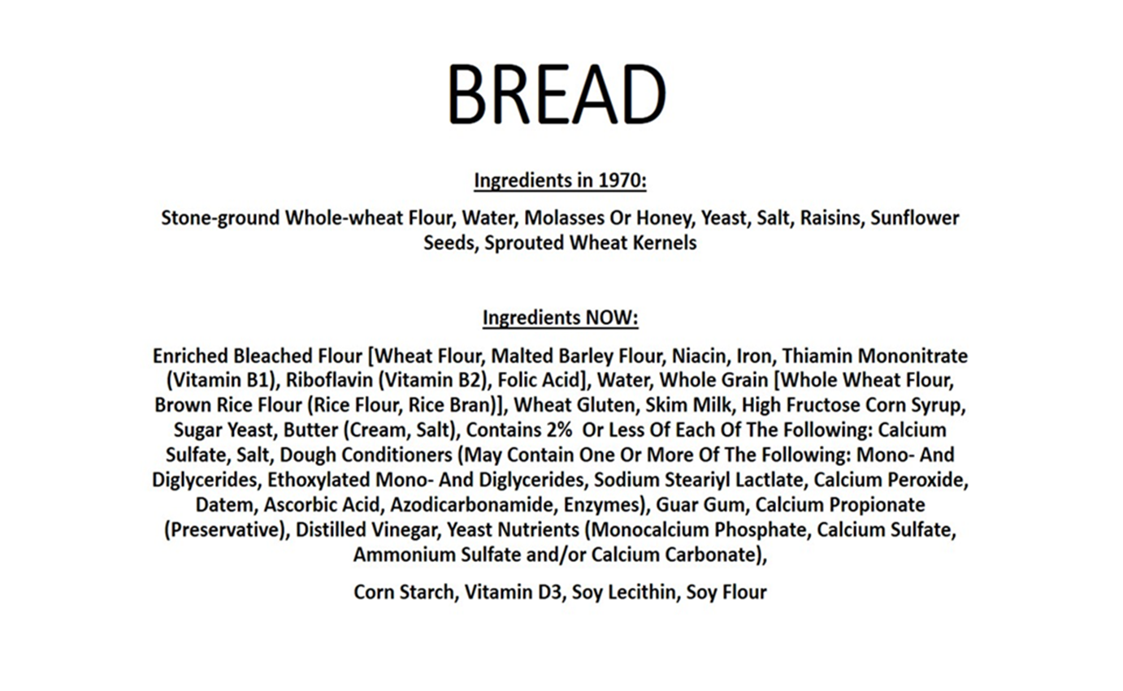

Slide 5
Reconnecting people with each other, their community and the natural environment using the language of food

Slide 6
Background – Incredible Edible Cloughmills
We started our journey looking over this wall in 2009

Slide 7
Dream to reality
When people work together, anything is possible

Slide 8
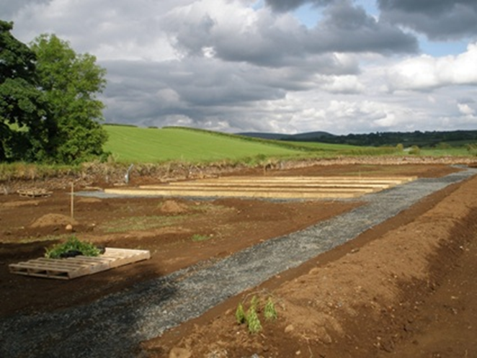
Need to keep dreaming
The Old Mill, Cloughmills, 2012

Slide 9
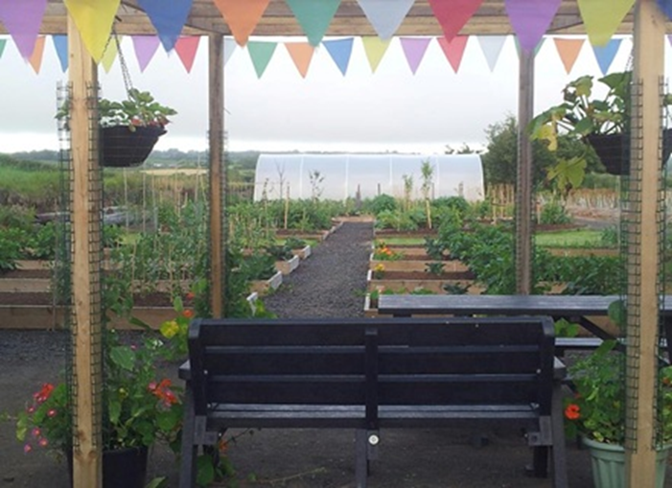
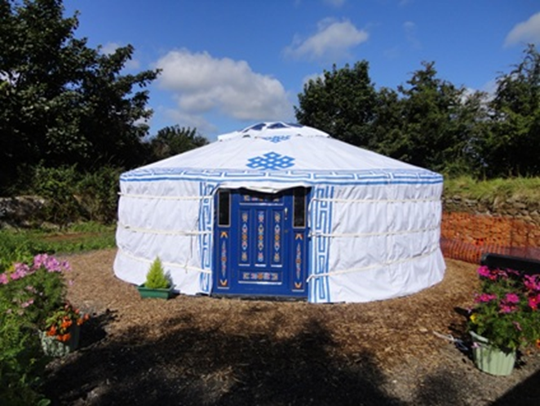
Dream to reality [2013]

Slide 10
What have we learned?
Food can be a game changer for communities
Focus on growing is great but too narrow
People are fascinated by food in all its forms
Food can bring people together, whether through growing, cooking or eating!
We are all part of this food debate
‘If you eat, you’re in’

Slide 11
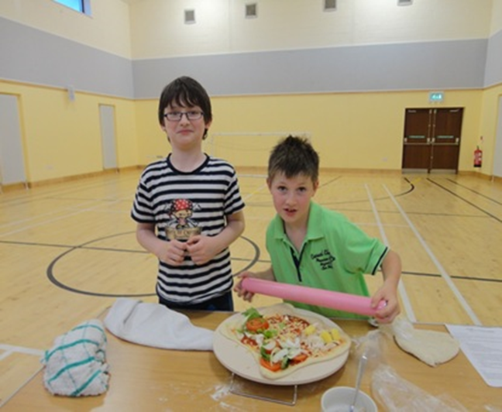
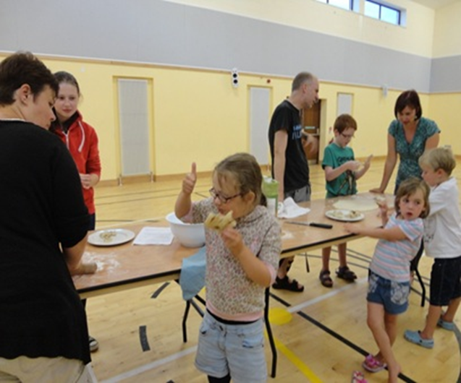
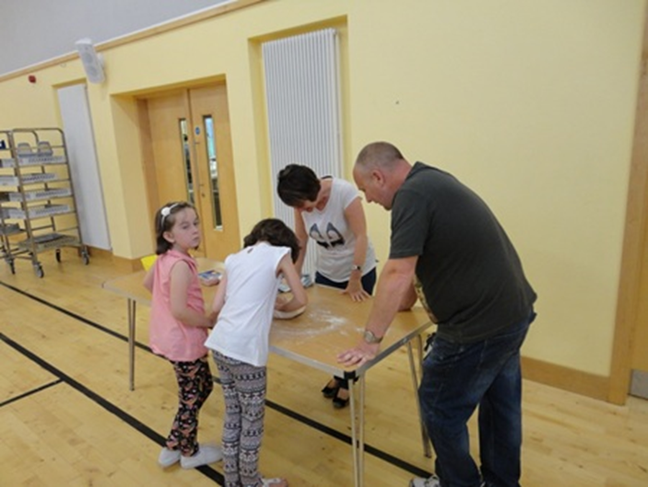
Pizza the action!

Slide 12
So, what did we do?
Range of ideas:
‘Souper Saturdays’ – teaching people to make simple soups
Baking in schools – eventually grow wheat and follow the process right through
Slow cooking – energy efficient, less equipment & ingredients
Potluck suppers – people got to taste different foods
Funny fruit face pancakes - children learn a skill but also have fun with food or as we say...PLEASE play with your food

Slide 13
Food for thought
We need to start early

Slide 14
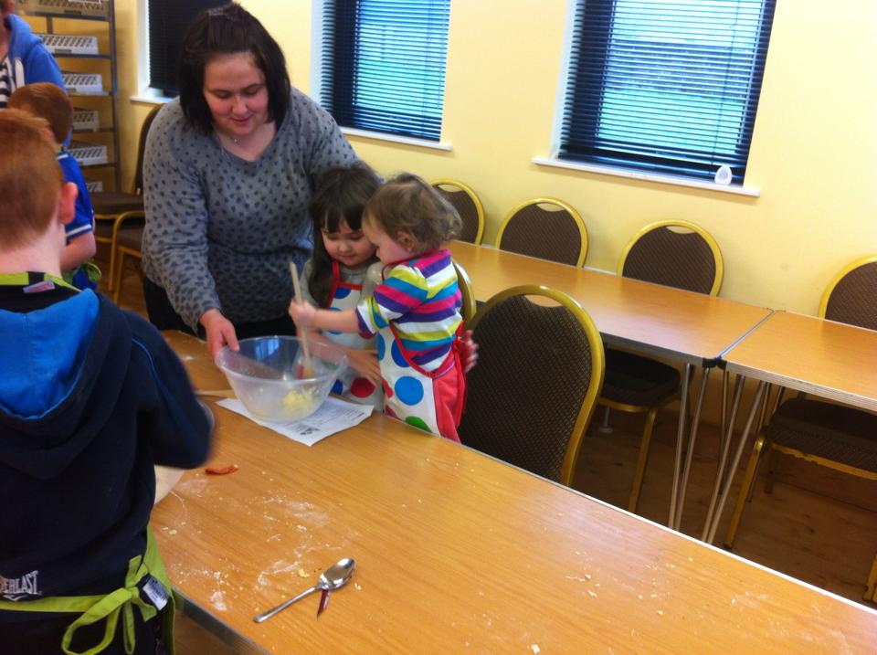
It is messy

Slide 15
The Pig Club

Slide 16
The relationship with food starts early

Slide 17
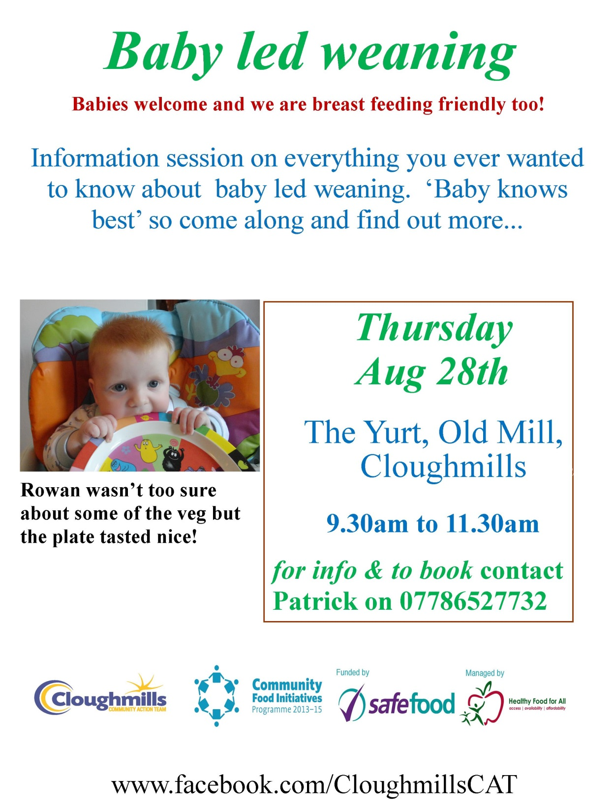

Slide 18
Bringing people together

Slide 19
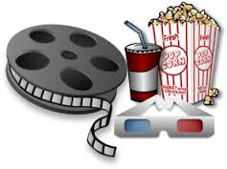
The Big Screen comes to Cloughmills

Slide 20
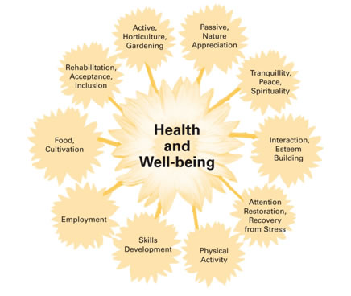
Social and therapeutic horticulture

Slide 21
But….
The serious side is that people are facing food poverty, even in Cloughmills.
As part of our evaluations, people reported missing meals because there wasn’t enough food in the home or because they fed children/other family members first
People don’t know how to cook
People have limited choices due to lack of transport etc

Slide 22
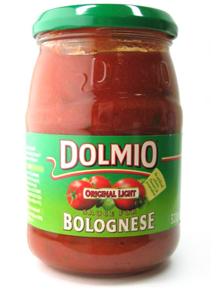
The Dolmio Factor

Slide 23
Food can have serious positive or negative physical and emotional health impacts
We have encountered people of all ages suffering emotionally as well as physically because of lack of food or lack of knowledge
So, food can heal
We are starting from the beginning – we are now a breast feeding friendly project and promote baby led weaning – form habits early!

Slide 25
This much we know…
It is hard work
It is hard motivating volunteers
It is important to ask people what they would like
It is fun when it all comes together
It must start small
You do not know where it will lead
It is important
It does make a difference to people in different ways
It does bring people together
It does work
It is fun [so important we use it twice]

Slide 26
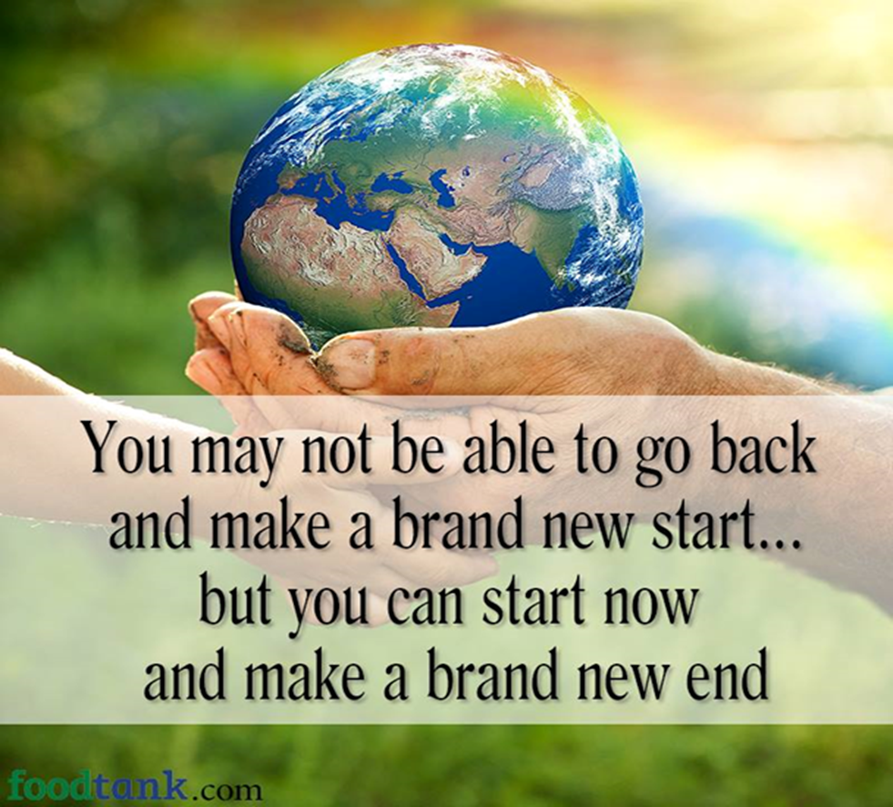

Slide 27
