Slide 1
Community Development Workshop.
Professor Mike Kelly
Institute of Public Health
University of Cambridge

Slide 2
The difference between population health and individual health

Slide 3
The difference between population health and individual health
Why is Mr Smith sick?

Slide 4
The difference between population health and individual health
Why is Mr Smith sick?
Why is the health of the population of the West of Scotland worse than everywhere else in the UK?

Slide 5
The difference between population health and individual health
Why is Mr Smith sick?
Why is the health of the population of the West of Scotland worse than everywhere else in the UK?
We need two different explanations!!

Slide 6
X
Y

Slide 7
^{A}
B

Slide 8
Two explanations
Individual
Population

Slide 9
Population explanations are not achieved by adding up all the individual events.
The case of asbestos related disease in East London

Slide 10
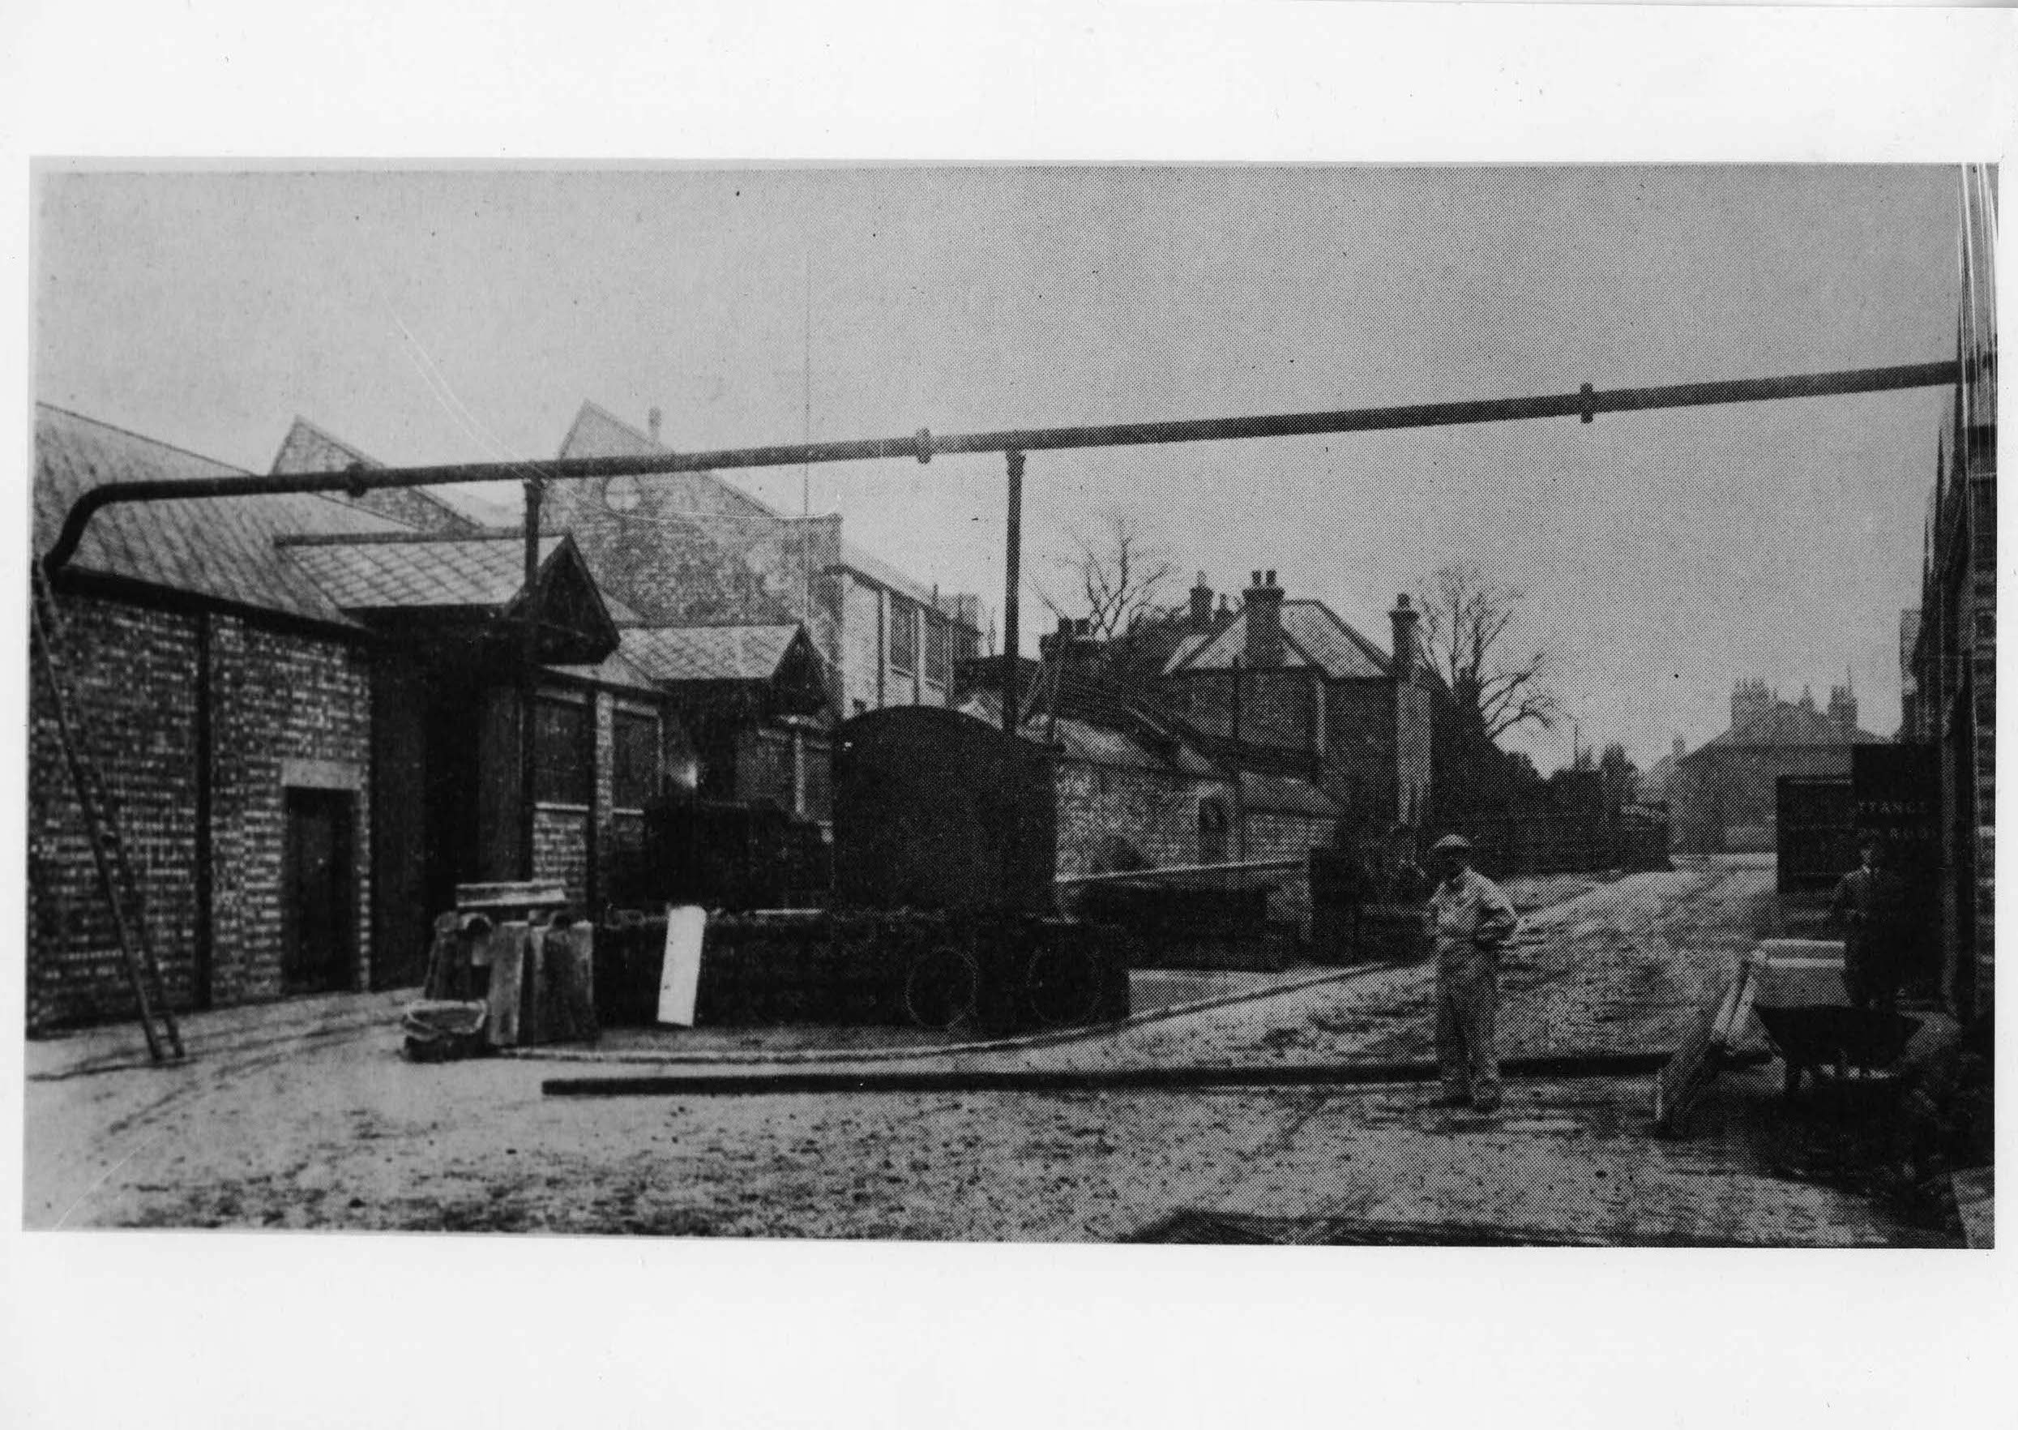

Slide 11
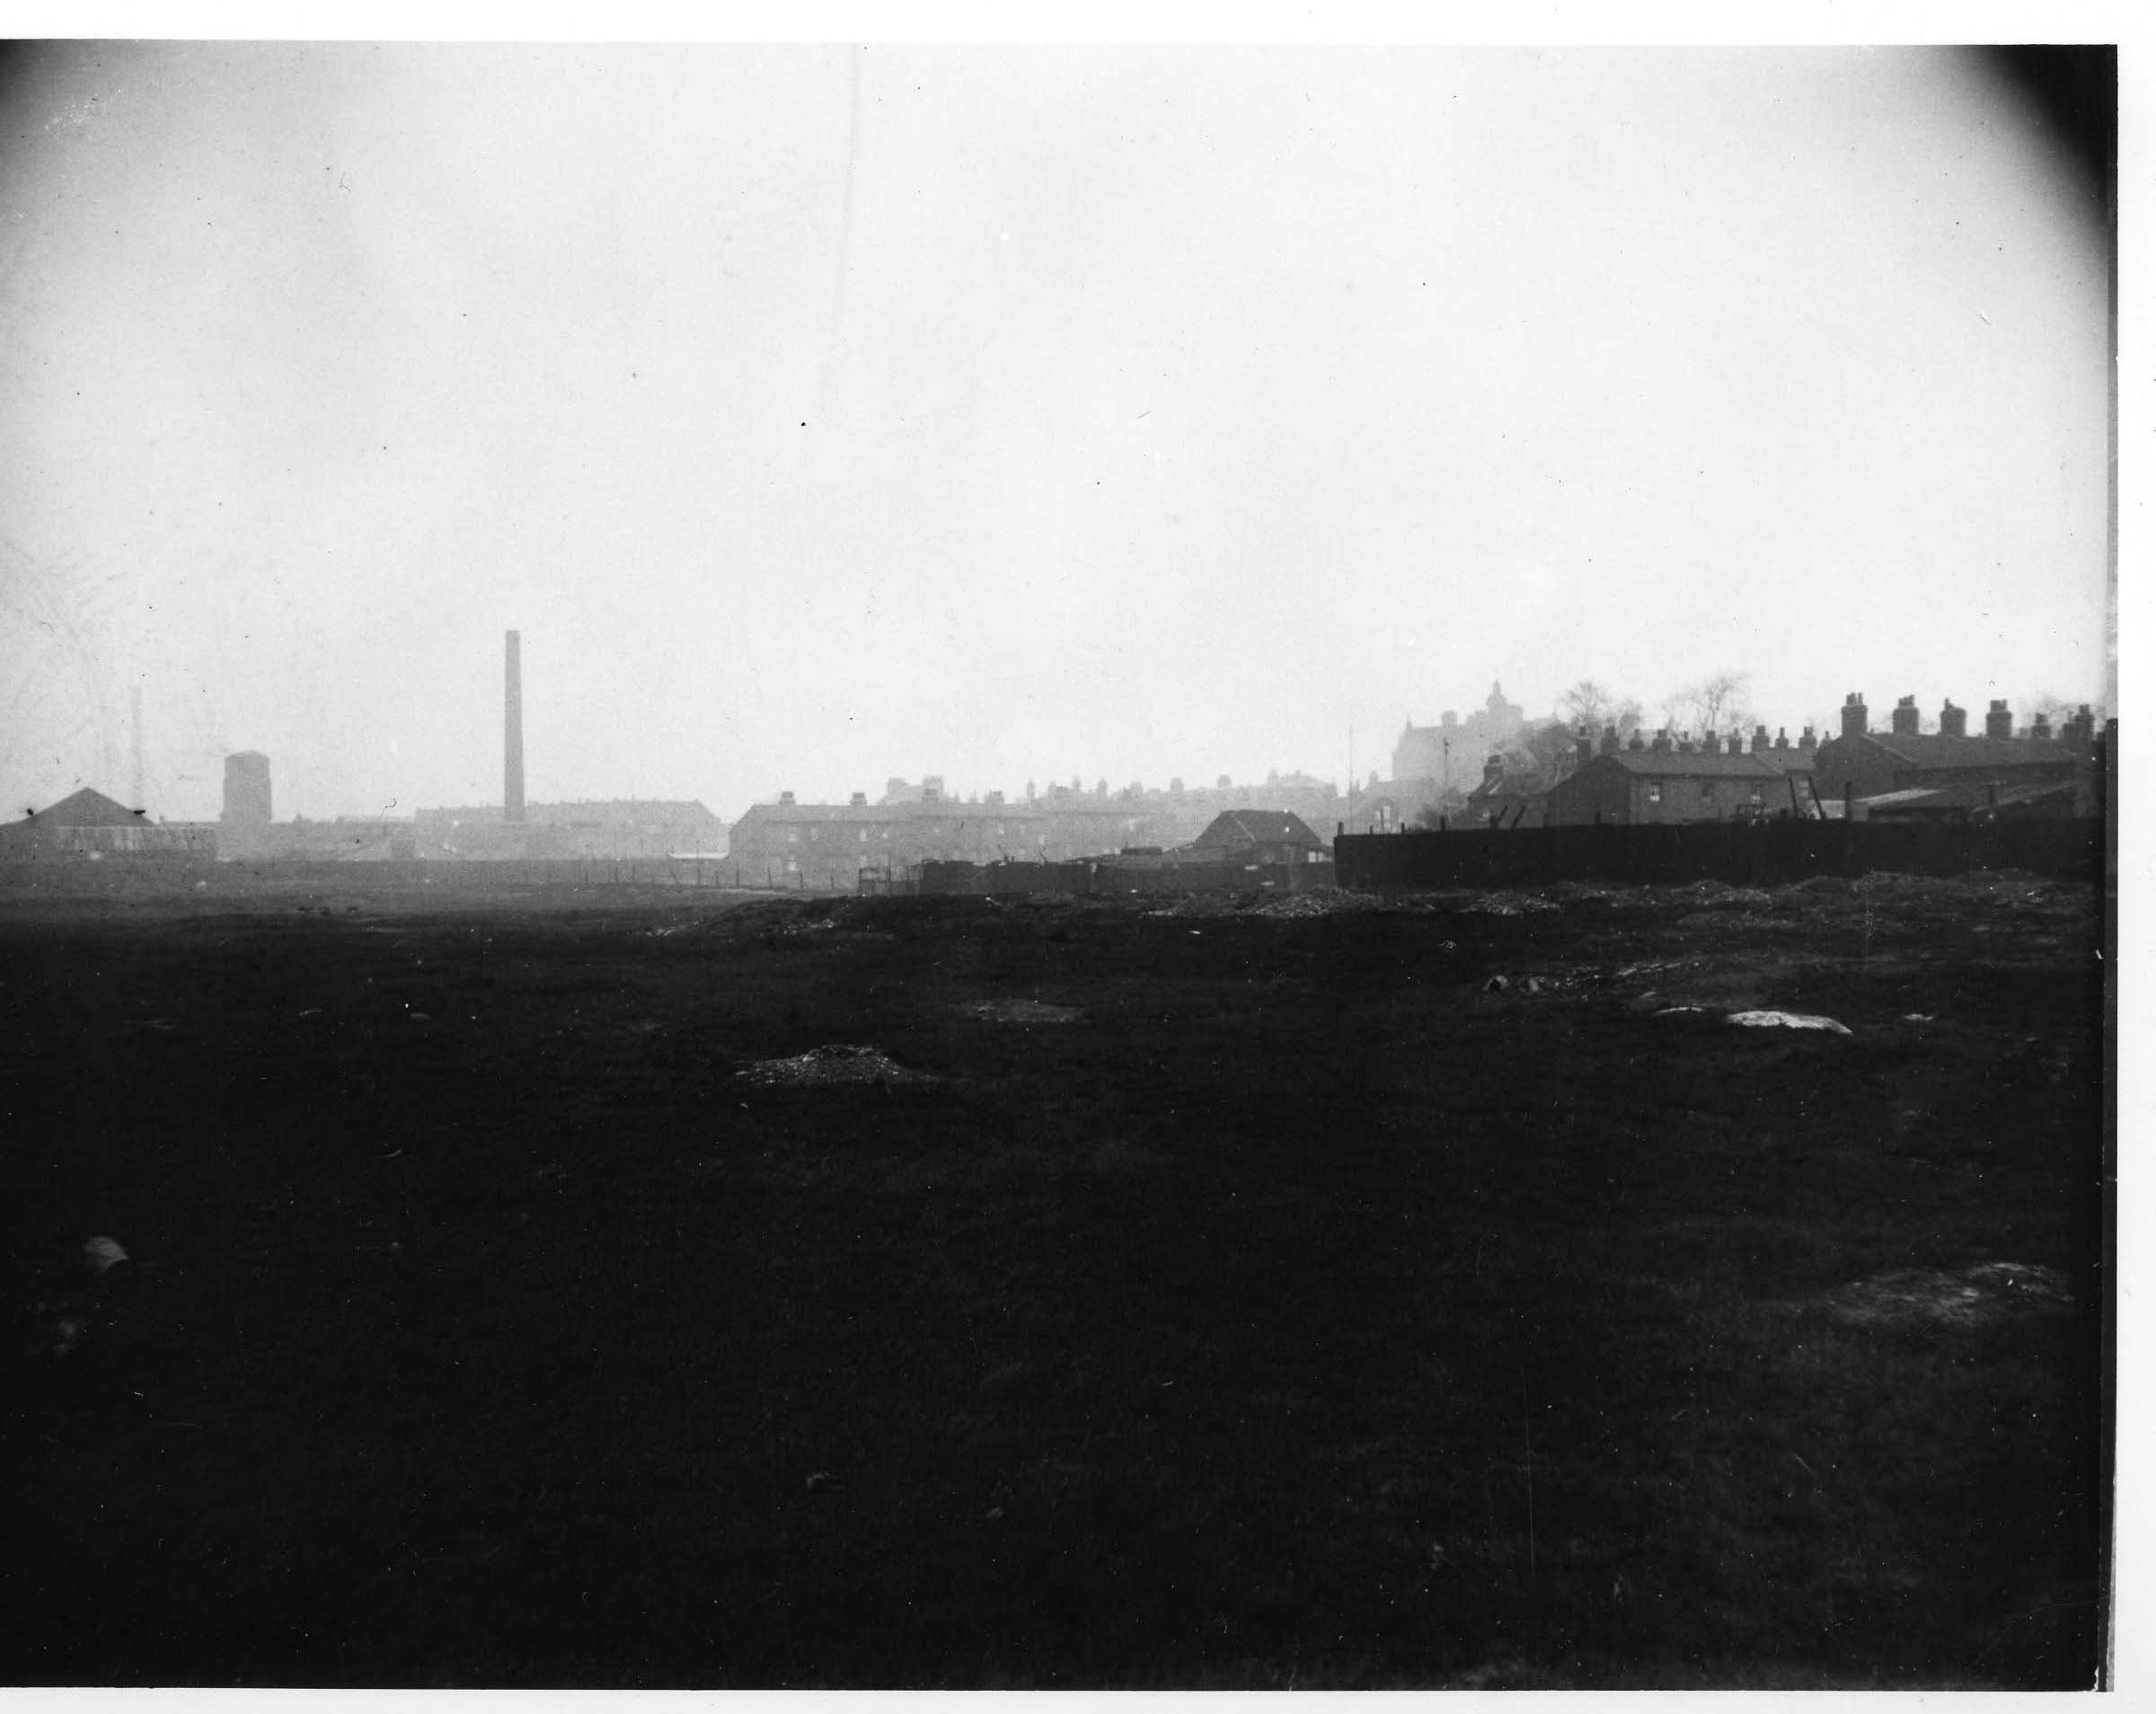

Slide 12
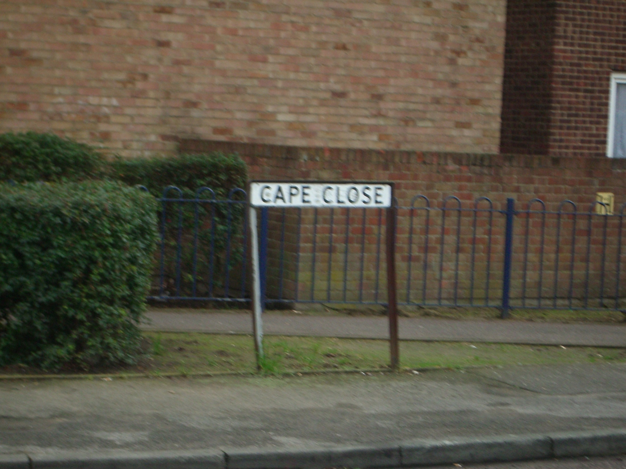

Slide 13
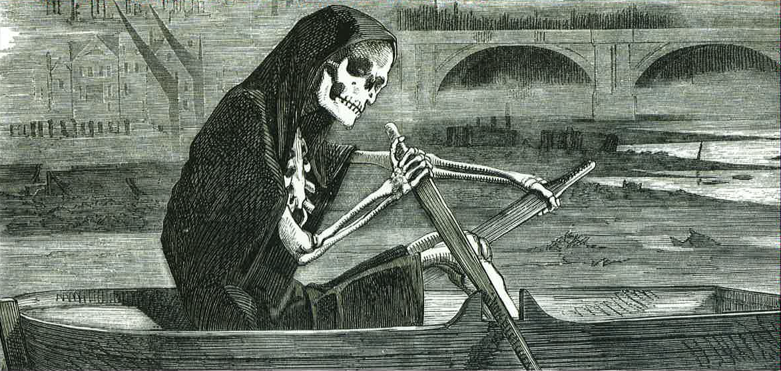

Slide 14
Technical solutions

Slide 15
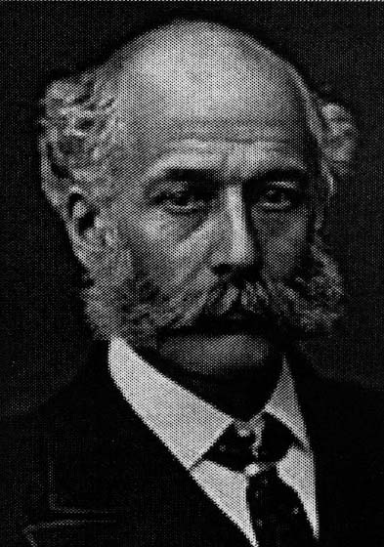

Slide 16
Water and sewerage as the most widely diffused technological complex in human history – Christopher Hamlin, Public Health and Social Justice in the Age of Chadwick, Cambridge University Press, 1998

Slide 17
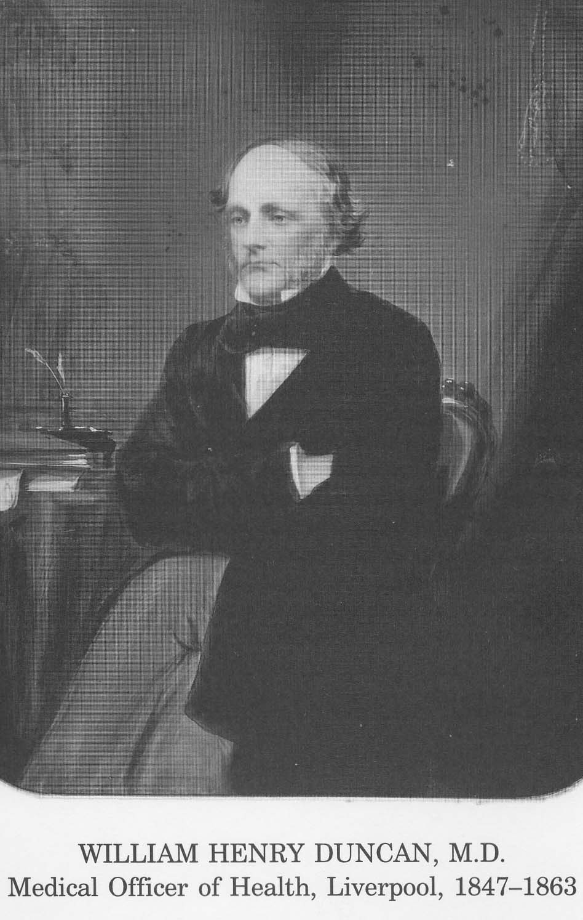
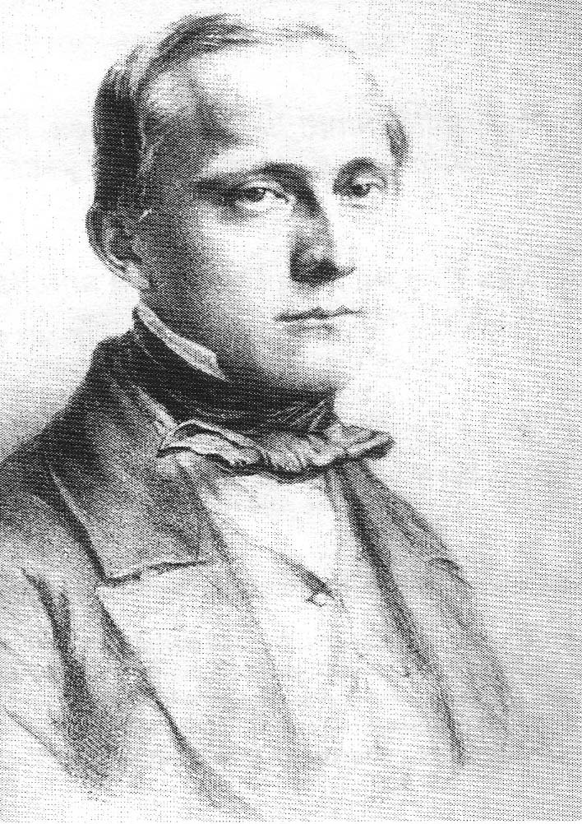

Slide 18
“Medicine is a social science, and politics is nothing else but medicine on a large scale. Medicine, as a social science, as the science of human beings, has the obligation to point out problems and to attempt their theoretical solution: the politician, the practical anthropologist, must find the means for their actual solution....The physicians are the natural attorneys of the poor, and social problems fall to a large extent within their jurisdiction.”

Slide 19
“The nation, which is but the aggregate of us all is …little disposed to endure a medical tyrant…Mr Chadwick and Dr Southwood Smith have been deposed, and we prefer to take our chance of cholera and the rest than be bullied into health…”
The Times 1st August 1854, p8.

Slide 20
E
G
I
K
X
A
B
C
D
Y
F
H
J
L
Notes:
Ray Pawson is a researcher that has worked primary in public health looking at the pitfalls of changing cultures and working practices when implementing new initiatives.
He notes that
To get from A to B - your vision to the reality
There are a number of issues that need to be dealt with along the way and if possible planned for in advance.

Slide 21
Antonovsky’s ideas
The pathogenic approach

Slide 22
Antonovsky’s ideas
The pathogenic approach.
Antonovsky’s studies of blue collar workers in the USA.

Slide 23
Antonovsky’s ideas
The pathogenic approach.
Antonovsky’s studies of blue collar workers in the USA.
Antonovsky goes to Israel via Aberdeen

Slide 24
Antonovsky’s ideas
The pathogenic approach.
Antonovsky’s studies of blue collar workers in the USA.
Antonovsky goes to Israel via Aberdeen.
The pathogenic approach asks the wrong question.

Slide 25
Antonovsky’s ideas
The pathogenic approach.
Antonovsky’s studies of blue collar workers in the USA.
Antonovsky goes to Israel via Aberdeen.
The pathogenic approach asks the wrong question.
Salutogenesis

Slide 26
Antonovsky’s ideas
The pathogenic approach.
Antonovsky’s studies of blue collar workers in the USA.
Antonovsky goes to Israel via Aberdeen.
The pathogenic approach asks the wrong question.
Salutogenesis
Resilience, coping, and sense of coherence

Slide 27
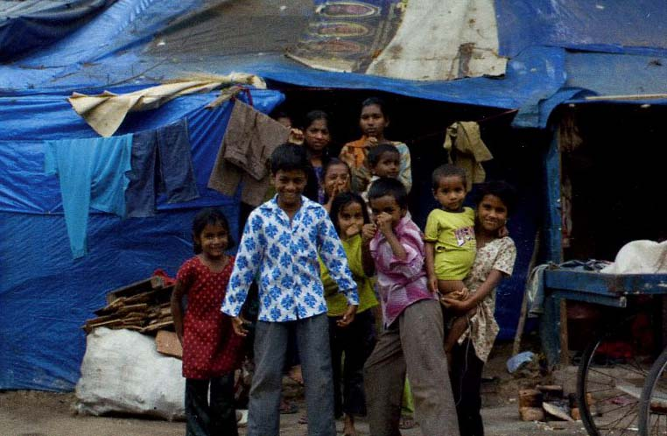
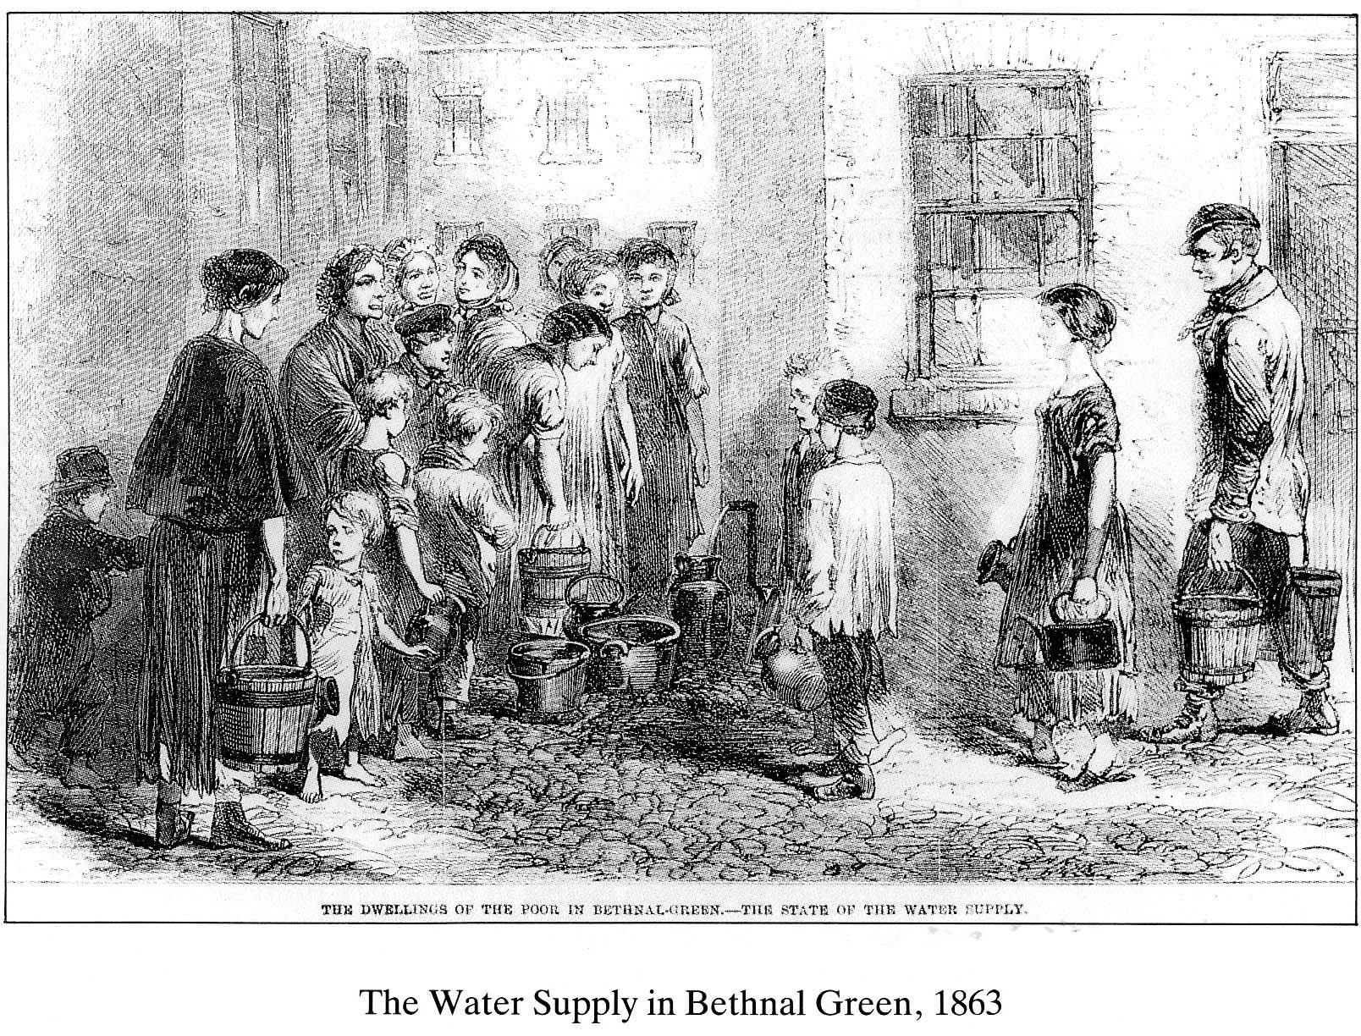
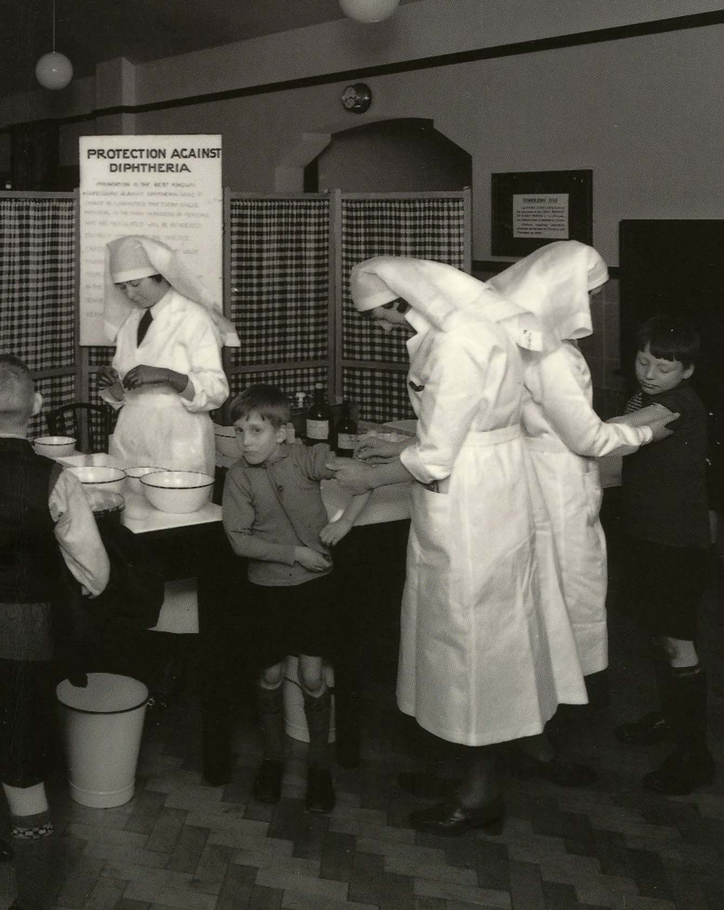
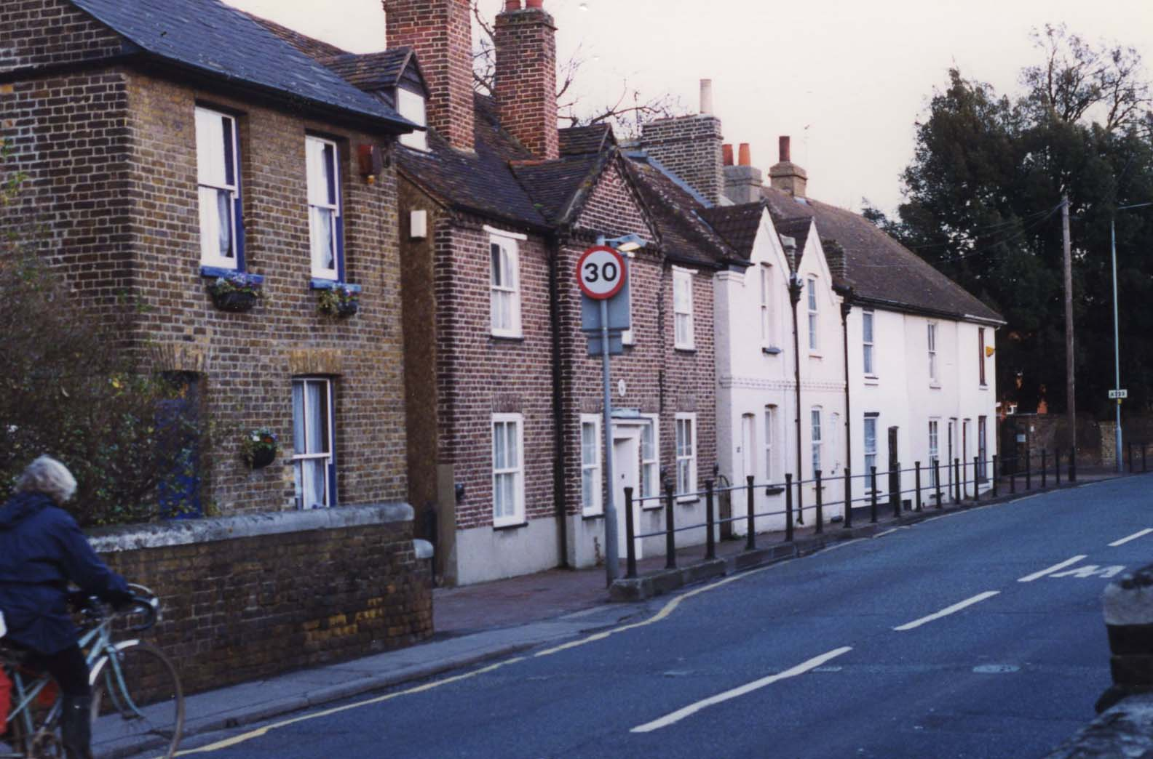
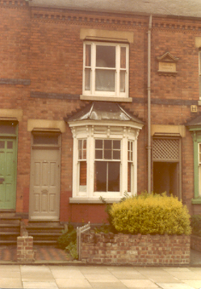

Slide 28
Where does coping take place?

Slide 29
Lifeworlds

Slide 30
Centre of the lifeworld
Zone of relevance
Zone of relevance
Zone of relevance
Outer zones of the lifeworld

Slide 32
Overlapping lifeworlds

Slide 33
Coping in the life world
Technical skills.
Interpersonal relationships.
Feelings, emotions.
Making it make sense.

Slide 34
Capabilities
Sen, A. (2009) The Idea of Justice, London: Allen Lane

Slide 35
Justice is not about finding or describing the perfectly just society.
Justice is about behaviour and relationships between people it is about behaviour.
The capability approach emphasises a person’s capability to do things he or she has reason to value.
The focus here is on the freedom that a person actually has to do this or be that – things that he or she may value doing or being.
It is about the opportunities for living, not just existing.
.

Slide 36
We don’t want you to be a different person, or a perfect person, but there are things you can do which will help you realise your capabilities.

Slide 37
How do we do this? .

Slide 38
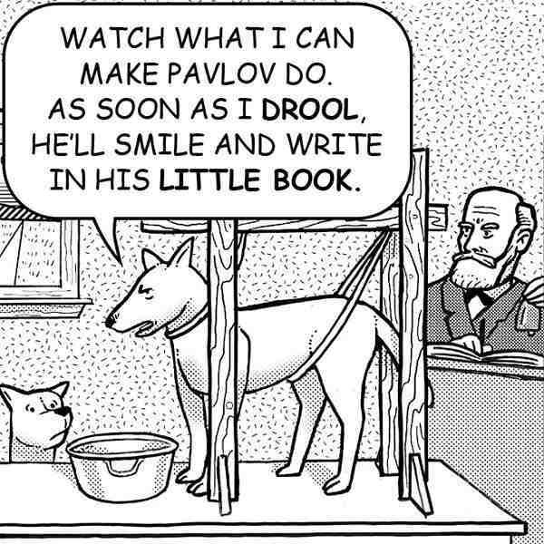

Slide 39
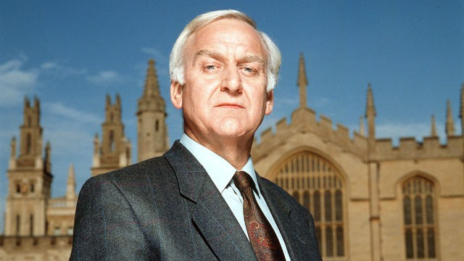

Slide 40
X
D
A
Y
X¹
C
B

Slide 41
X⁴
P
O
X²
H
N
G
M
F
E
X¹
D
C
B
A
Y
I
J
K
Q
L
X³
R
S
T
X⁵

Slide 42
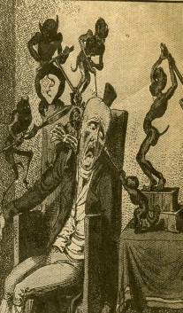
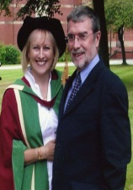
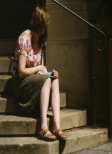
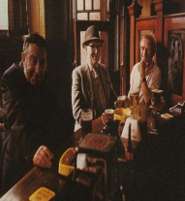
⁴
P
O
H
N
G
M
F
E
X¹
D
C
B
A
Y
I
J
K
Q
L
X³
R
S
T
X⁵

Slide 43
Delivering public health improvement using the evidence

Slide 44
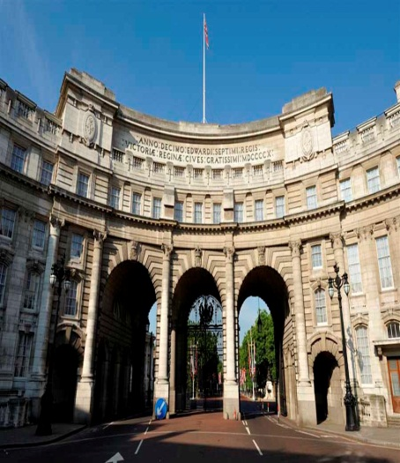
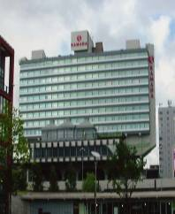
NICE
The National Institute for Health and Care Excellence (NICE) is the independent organisation in the UK responsible for providing evidence based national guidance to Local Authorities, the NHS and the wider public health community on the promotion of good health and the prevention and treatment of ill health.
Notes:
What is NICE ?
The National Institute for Health and Clinical Excellence (NICE) is the independent organisation responsible for providing national guidance on the promotion of good health and the prevention and treatment of ill health.

Slide 45
The legacy of Archie Cochrane
Effectiveness and Efficiency (1972)

Slide 46
Do we know whether intervention x for public health problem y is effective?
How do we know it is effective?
How do we know whether it is more or less effective than intervention z?
On what basis do we make that judgement of effectiveness?
Do we know what it costs? And is it cost effective?
If it is not cost effective, why is it still being used?
What are the dangers posed to the public of interventions and actions about which we are scientifically uncertain?
Are the interventions dangerous? Why are we using potentially dangerous or worthless interventions?

Slide 47
The implementation gap

Slide 48
There is an extensive evidence base about what works and about what is cost effective.
The failure of the last two decades has been not to implement that which is known in favour of doing gimmicks, bright ideas, common sense, rolling out pilots, vision statements, etc. etc.

Slide 49
Some evidence to policy successes
The breathalyser and drink driving legislation
Seat belt legislation
The smoking ban
The response to HIV AIDs

Slide 50
The pillars of NICE’s work
Comprehensive evidence base
Detailed appraisal of the evidence
Expert input
Patient and carer involvement and community engagement.
Independent advisory committees
Genuine consultation
Regular review
Open and transparent process.

Slide 51
Assessing Cost Effectiveness
1
Probability of rejection
x
XX
XX
0
10
20
30
40
50
Cost per QALY (£K)

Slide 52
From: Heath I (2006) Combating Disease Mongering: Daunting but Nonetheless Essential. PLoS Med 3(4): e146. doi:10.1371/journal.pmed.0030146

Slide 54
The health gradient
Hi
Health state
Lo
Hi
Lo
Social status

Slide 55
The health gradient
Hi
Health state
Lo
Hi
Lo
Social status

Slide 56
The health gradient
Hi
Health state
Lo
Hi
Lo
Social status

Slide 57
Shifting the health gradient
Hi
Health state
Lo
Hi
Lo
Social status

Slide 58
Social Practice.

Slide 59
materials (objects, consumer goods, infrastructures);
competence (including understandings of the situation; practical know-how)
meanings (including embodied understandings of the social significance of the practice; past experiences of participation etc.).

Slide 61
Agency and structure.
Knowledgeable social actors.
The recursive nature of social life.
Typifications.
Giddens A (1984) The Constitution of Society: Outline of the Theory of Structuration. Cambridge: Polity.

