Slide 1

Wellbeing – what it is and how to align with economic policy
Charles Seaford

Slide 2
Contents
What is wellbeing?
Why should government make it a priority?
How can we align wellbeing and the economy as government priorities?

Slide 3
There are some good official definitions
A positive physical, social and mental state; it is not just the absence of pain, discomfort and incapacity. It requires that basic needs are met, that individuals have a sense of purpose, that they feel able to achieve important personal goals and participate in society.
  Government Whitehall Well-Being Working Group (W3G) (2007)
This is a dynamic state, in which the individual is able to develop their potential, work productively and creatively, build strong and positive relationships with others, and contribute to their community.
  Foresight Review (2008) – ‘Mental wellbeing’

Slide 4
A simpler definition
Good feelings
Living a good life
Adapted from Foresight (2008)

Slide 5
What causes it?
Good feelings
Living a good life
External
conditions
Personal
resources
Adapted from Foresight (2008)

Slide 6
How do we measure it?
Good feelings
How happy did you feel yesterday?
How anxious did you feel yesterday?
How satisfied are you with your life nowadays?
To what extent do you feel that the things you do in your life are worthwhile?
Living a good life
External
conditions
Personal
resources
Adapted from Foresight (2008)

Slide 7
Contents
What is wellbeing?
Why should government make it a priority?
How can we align wellbeing and the economy as government priorities?

Slide 8
Prioritising wellbeing is a policy tool
Everyone wants a good life, wellbeing…
All government priorities reflect beliefs about what will help create good lives
  Healthcare, growth, education
Prioritising ‘wellbeing’ is not instead of these
It is a way of balancing conflicting demands – using evidence about what causes wellbeing
…so improving effectiveness of policies and spending

Slide 9
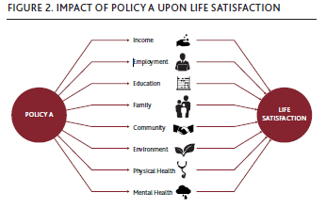
In principle you can then assess policy impacts
Source: Gus O’Donnell et al, ‘Well-being and Policy’

Slide 10
It can also draw attention to problems…
The bottom quintile in UK score 4.6 less than the top quintile (4.8 vs 9.5/10), one of the most unequal distributions in Europe
GDP rose but life satisfaction fell in the years before the revolution in Egypt

Slide 11
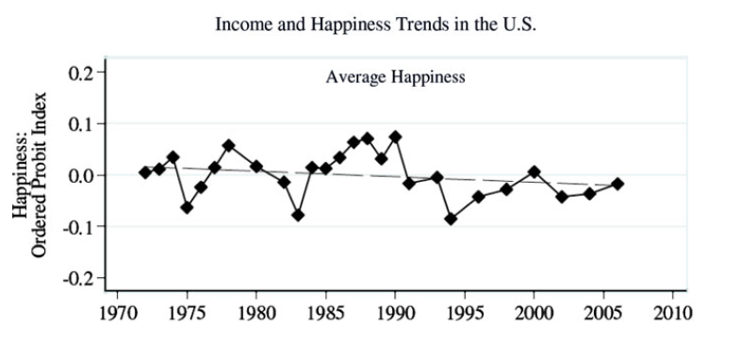
Including negative long term trends
Bartolini & Bilancini 2010

Slide 12
Income is important up to a certain level
Understanding Society Survey, 2009-2010

Slide 13
The evidence allows us to quantify the impacts of material deprivation
Not being able to afford one item – equivalent to 56% loss in income
Not being able to afford two – equivalent to 81% loss in income
Source: European Quality of Life Survey, 2011

Slide 14
Unemployment and job insecurity are very important

Slide 15
Perceived job insecurity is important…
How likely do you think it is that you might lose your job in the next 6 months?
European Quality of Life Survey, 2011

Slide 16
…as is the right number of working hours
Affects over a quarter of working adults in sample
Significant effect even when excluding top income quartile

Slide 17
…and social capital
Changes in social capital seem to predict changes in well-being over time

Slide 18
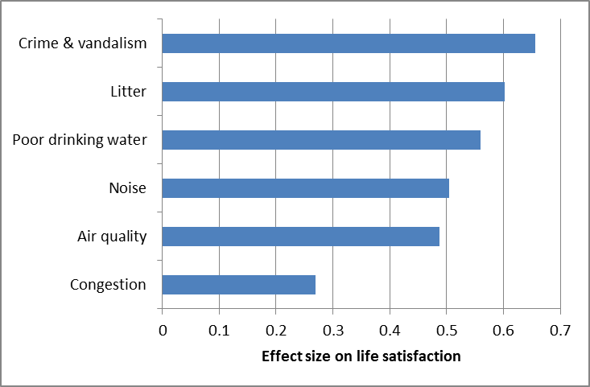
Neighbourhood issues are important

Slide 19
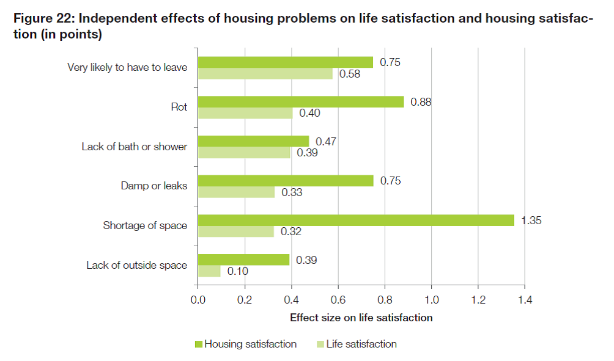
…as is housing…

Slide 20
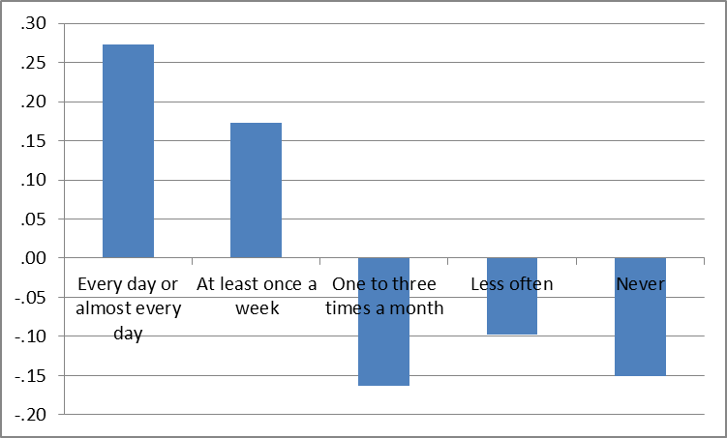
…and physical activity
Never participating in sport equivalent to 48% loss in income

Slide 21
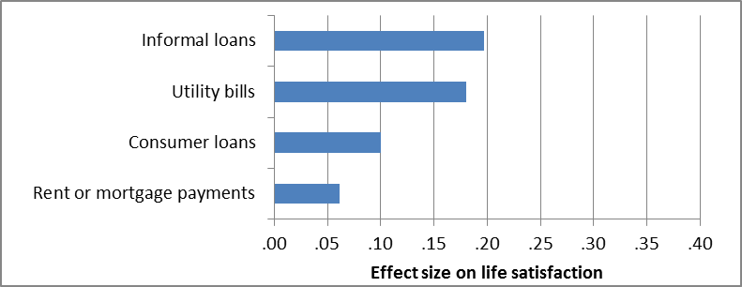
Debt can be very damaging
Uncontrollable debts, or arrears, have been known to have a strong negative impact on mental health
Having one item of debt had the same effect on life satisfaction as a 29% loss in income

Slide 22
In short there is evidence to use about the drivers of wellbeing – and their relative importance
Income and employment
Decent income – no deprivation
Secure income and employment
Economic stability more broadly
Housing
Limited amounts of debt
Employment
Hours worked/enough time
Other aspects of a good job
Activity
Caring for children – but not the elderly
Volunteering and giving
Short commute times
Physical activity
Cultural activity
Education
Education
Health
Health and vitality
Good sleep
Relationships and social capital
Social activity, friends, family life
Membership of clubs and institutions
Trust of neighbours/other people
The local environment
Clean, unvandalised local environment
Green space, trees
Accessible amenities
Good quality drinking water
Low levels of noise and pollution
Society as a whole
Equality
Freedom
Governance and trust in institutions
Low levels of crime, physical security
* Based mainly on life sat correlations

Slide 23

The Cabinet Office has set up a ‘What Works Centre for Wellbeing’
Gathering together evidence to improve policy and practice – including for private sector
Three main areas
  Wellbeing at work
  Culture and sport
  Communities, including built environment, public space etc

Slide 24
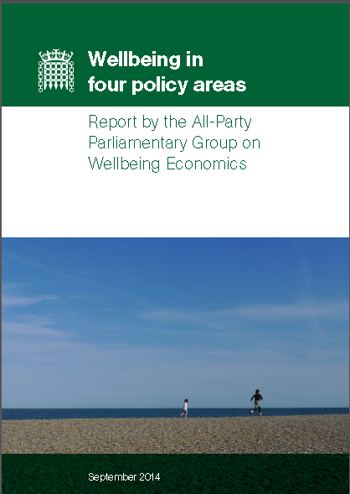
MPs have been pressing for wellbeing policy…
Government should have wellbeing strategy
Policy should be assessed routinely for wellbeing impact
Stable and secure employment should be first objective of economic policy
Low pay and inequality should be priorities
Wellbeing should be framework for planning and culture policy

Slide 25
And the agenda is recognised internationally
“…progress is a multidimensional concept that goes beyond GDP. It must incorporate other dimensions such as the environment, equity considerations and well-being. We need to better understand the interactions, synergies and trade-offs among these different dimensions to draw the appropriate policy implications and advice. We need …to … develop policy tools to ensure that the benefits of growth… contribute to an improvement in overall social well-being.”
OECD Secretary-General’s Report to Ministers 2012

Slide 26
Contents
What is wellbeing?
Why should government make it a priority?
How can we align wellbeing and the economy as government priorities?

Slide 27
Eight important economic drivers…
Income - up to a certain level
Equality
Low unemployment
Economic stability
Other components of a good job – including the right hours
The way we consume – which is not optimised
Low personal debt
Relationships and social capital – which are influenced by the economy

Slide 28
…and five objectives
Income - up to a certain level
Equality
Low unemployment
Economic stability
Other components of a good job – including the right hours
The way we consume – which is not optimised
Low personal debt
Relationships and social capital – which are influenced by the economy
A target band of income for everyone
Economic and social stability and full employment across the country
Satisfying work for all…
…and in the right quantities
Encouraging active forms of consumption and correcting biases created by advertising

Slide 29
…suggesting four sets of policies
A target band of income for everyone
Economic and social stability and full employment across the country
Satisfying work for all…
…and in the right quantities
Encouraging active forms of consumption and correcting biases created by advertising
An industrial strategy designed to create good jobs
  Business bank
  Inward/local investment
  Infrastructure
  Skills
  Research/transfer
  Trade
  Ownership models
  Co-ordination
Public sector employment and procurement practices
Effective trade unionism
Wage policies (ratios, living)

Slide 30
…and an approach to policy making
An industrial strategy designed to create good jobs
  Business bank
  Inward/local investment
  Infrastructure
  Skills
  Research/transfer
  Trade
  Ownership models
  Co-ordination
Public sector employment and procurement practices
Effective trade unionism
Wage policies (ratios, living)
Using evidence to counter traditional economic orthodoxies
Effectively integrated policy-making…
Led from the top

Slide 31

Thank you
Charlesseaford@gmail.com

