Slide 1
Co-Production
My learning to date….
MEAAP Project Coordinator
Deirdre McCloskey

Slide 2
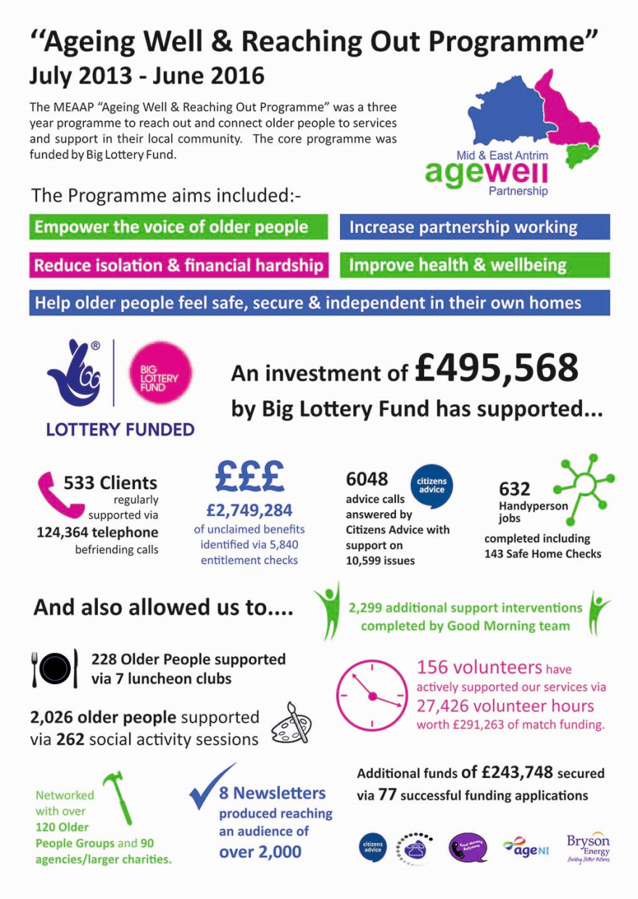
Who are MEAAP?
An older people’s charity set up in 2011 with the “aim of improving the lives of older people within the Mid & East Antrim area.”
We are not about “delivering projects” we are about “supporting people”!

Slide 3
Opportunities vs Obstacles!
MEAAP have been representing the needs of older people & older people groups on Integrated Care Partnership’s, NHSCT Older Peoples Panel, MEABC Community Planning.
Dunhill Medical Trust - Funding opportunity to “Develop a Network of Care for Older People at a Local Level” released in November 2015.
MEAAP seen this as an opportunity to not only talk about co-production but to challenge our statutory agencies to work alongside us to put the principles into practice!

Slide 4
‘Involving Many to Prescribe Alternative Care Together (IMPACT)’ Our Vision
Improve the quality of life for older people by providing them with person centred services and support to improve and meet the health and wellbeing outcomes that matter most to them - putting wellbeing on par with medical needs using an integrated healthcare model - thereby reducing dependency on the unscheduled use of primary & secondary health and social care services.

Slide 5
https://www.youtube.com/watch?v=ovHdUGBgFdA

Slide 6
Aligns with Co-Production Principles
It joins the dots between existing local agencies, groups & people.
Empowers older people to be active participants in their own health.
Restores a “balance of power”.
Blurs the lines, as we are all health care practitioners.
MEAAP are the lead applicant.
Invests & nurtures in communities vs signposting via local health & wellbeing hubs.

Slide 7
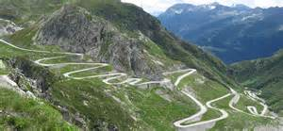
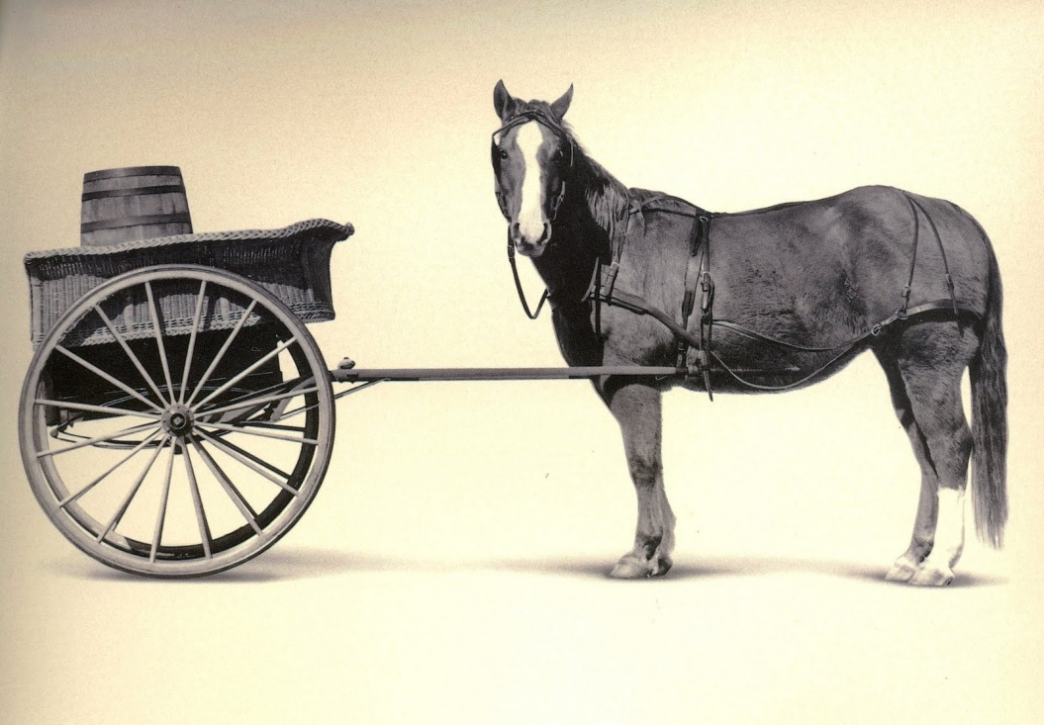
Learning to date…
Invest time, time, and more time!
Know when to take the lead, and when to be led.

Slide 8
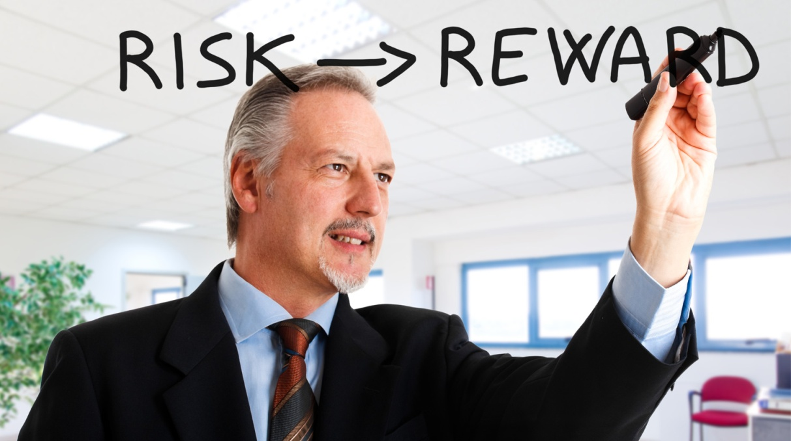
Learning to date…
Phone a friend – Coalition of Willing
Accept the Risk of Failure – It is a “First Attempt in Learning”

